Slide 1
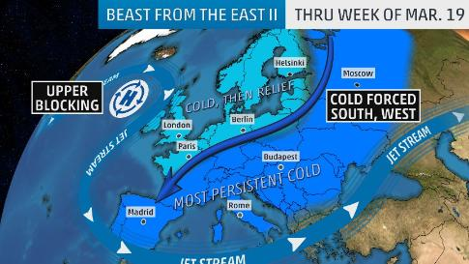
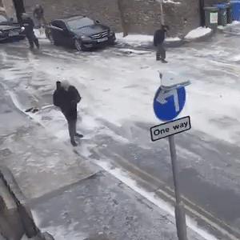
Beast from the East
…..
…….

Slide 2
Global warming
By Muhd Syamil bin Dzulkaftah

Slide 3
Summary
What is global warming?
What causes global warming?
What are the effects of global warming?
How can technology helps tackling global warming?
Conclusion

Slide 4
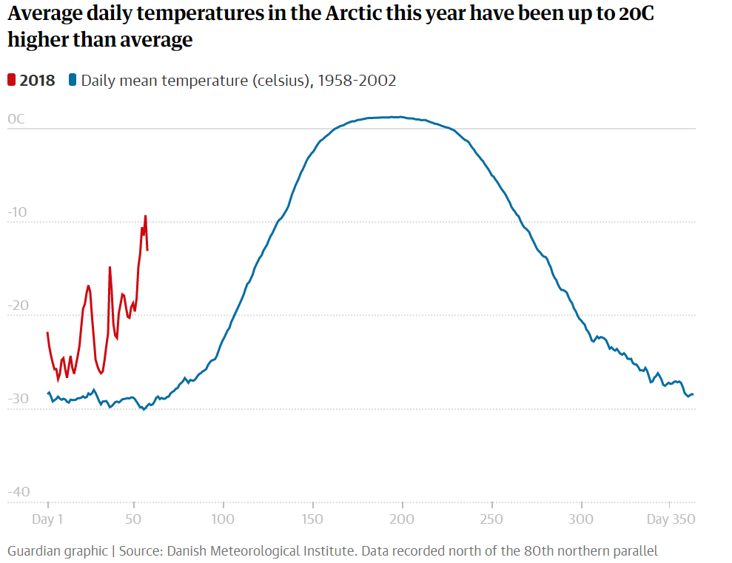
What is global warming?

Slide 5
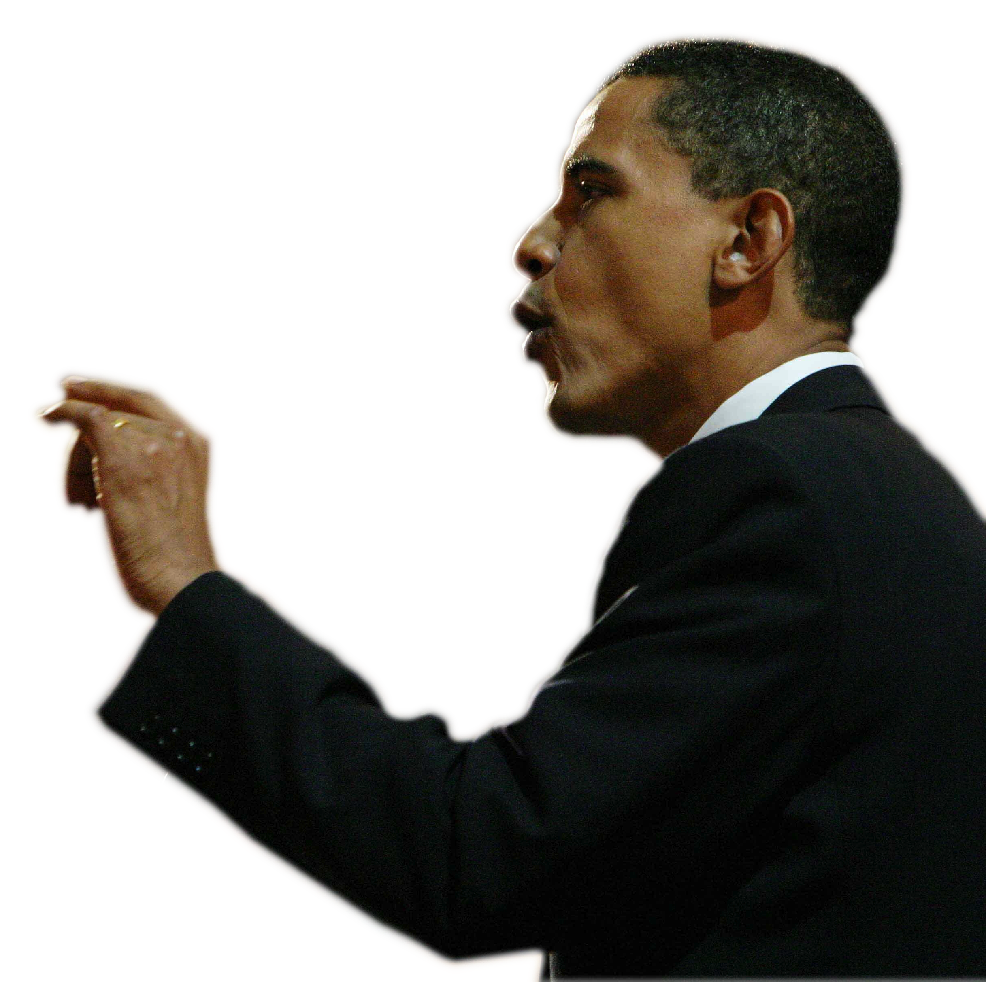
“Climate change is no longer some far-off problem;
it is happening here,
it is happening now”
Barack Obama

Slide 6
What causes global warming?
Enhanced greenhouse effect
Deforestation

Slide 7
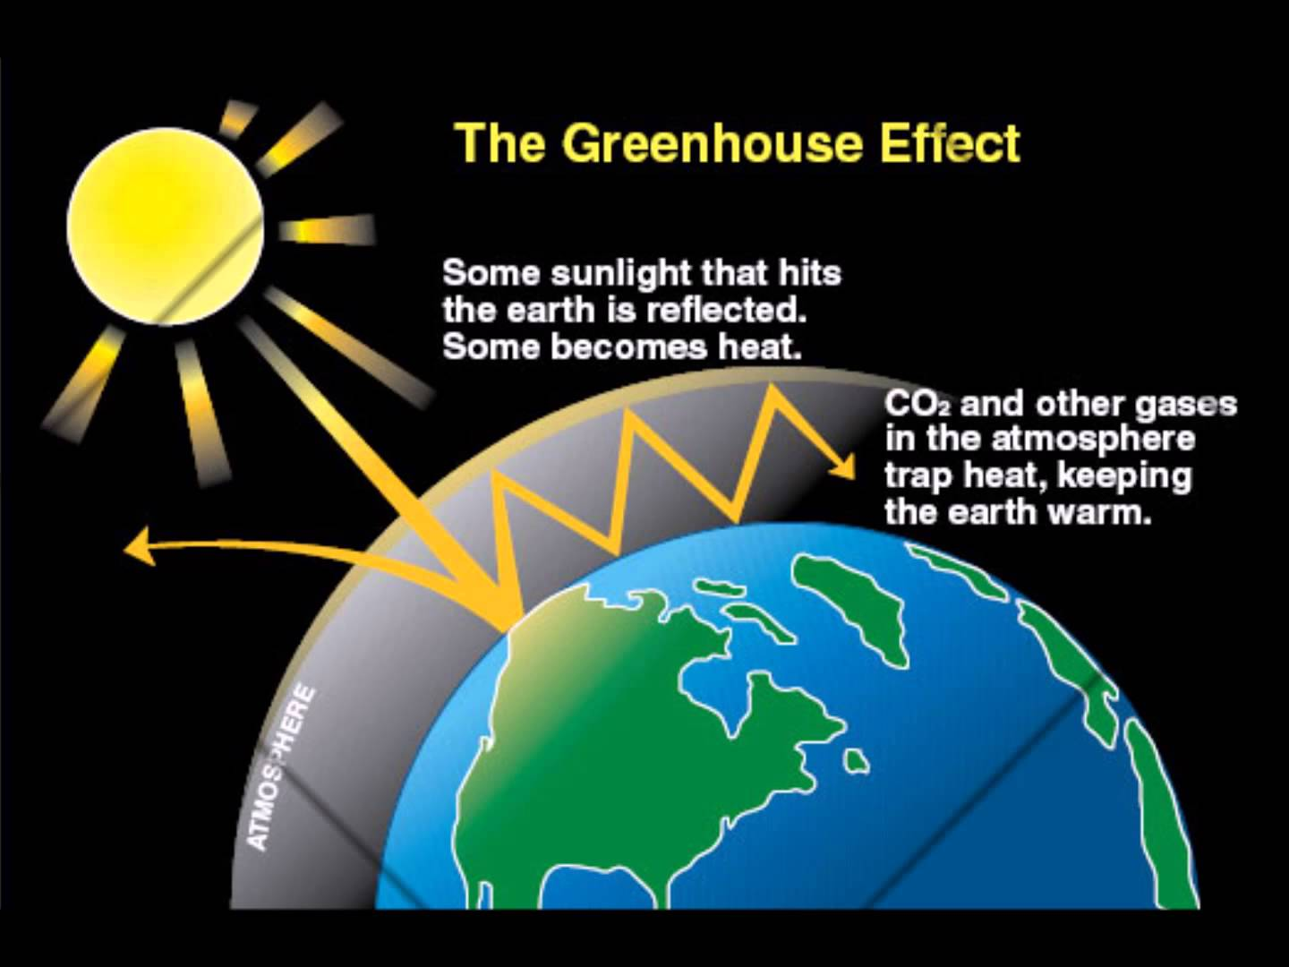
Human activities that are causing the concentration of the main greenhouse gases to rise :
Production and burning of fossil fuels
Uses of synthetic fertilizers for agriculture
Refrigeration, cooling and manufacturing applications.
Main greenhouse gases :
Carbon Dioxide, Methane, Nitrous Oxide, Fluorinated gases

Slide 8
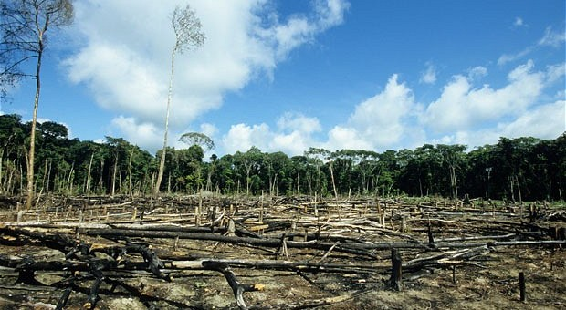
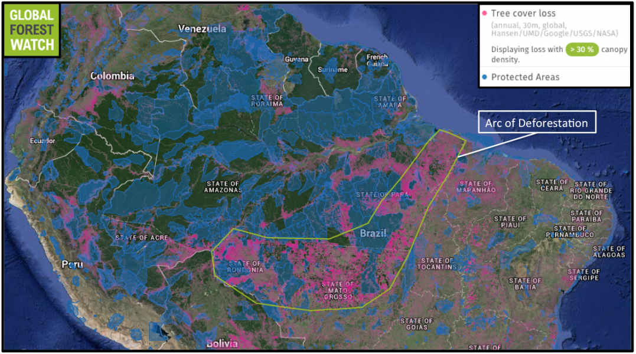
Deforestation
Nature alert : 22/11/2015

Slide 9
What are the effects of global warming?

Slide 10
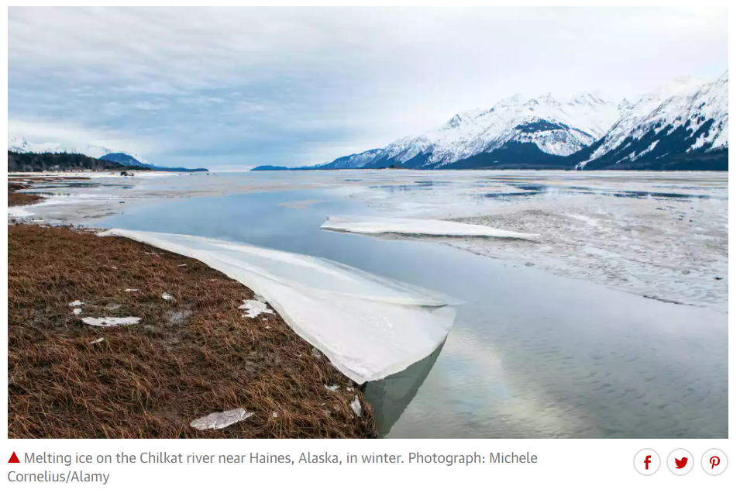
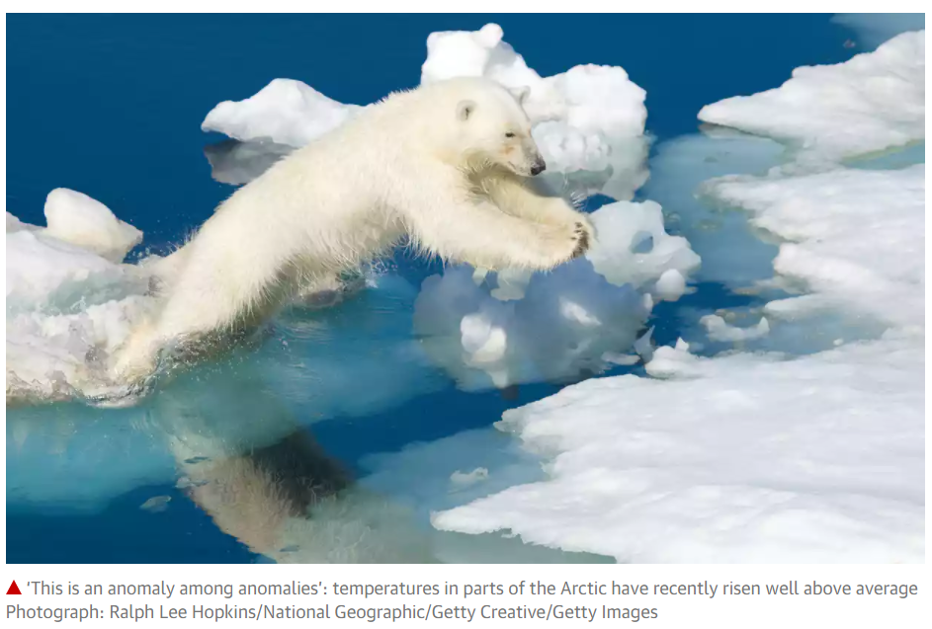
Increase melting of snow and ice

Slide 11

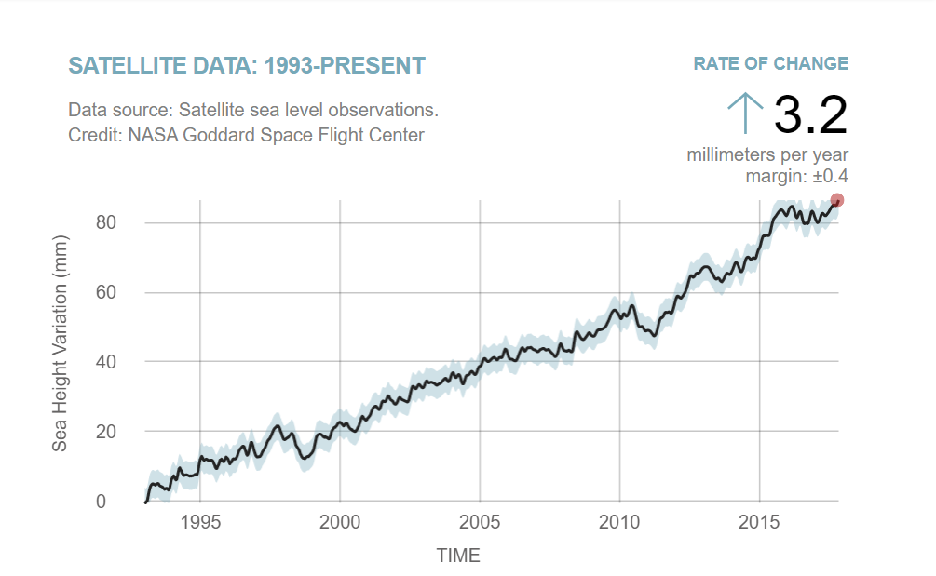
Rise of global sea level

Slide 12
Stronger hurricanes and cyclones
35% increases of Power Dissipation Index of tropical cyclones in the Pacific.
Double at Atlantic
1°C increase in sea surface temperature = 31% increase in the global frequency of category 4 and 5 storms.

Slide 13
How can technology helps tackling global warming?
Power generation :
Canadian company, General Fusion - nuclear-fusion-energy power plant
Transport :
New materials offering an alternative to battery power
Proven to be between 1000-10000 times more powerful
Manufacture :
Canadian startup, Carbon Engineering - taking out CO² from the air
Building :
Smart cities

Slide 14
Conclusion

Slide 15

Thank you for listening :)

